Slide 1


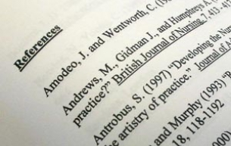
Referencing for Academic Success
IMAT1610
Marta Ulanicka
Centre for Learning and Study Support (CLaSS)
Enhancing academic practice, writing development and professional skills

Slide 2

In this session we will think about …
The anatomy of a citation/reference
Avoiding plagiarism
Direct quotations and paraphrasing

Slide 3

What do we mean by referencing?
Why do we reference?
Notes:
Students to discuss – what do we mean by referencing? Why do we reference?

Slide 4
Referencing is a way to acknowledge and respect other people’s ideas
Notes:
Referencing is a way to acknowledge and respect other people’s ideas

Slide 5
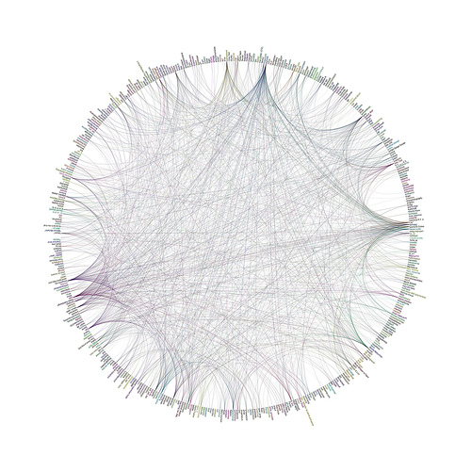
Referencing supports the collective construction of academic knowledge
Notes:
no research is entirely original, academic research is about building on the work of others and referencing encourages and support the collective construction of academic knowledge. References are links to this network of knowledge. Referencing shows you understand where ideas come from. It facilitates the transmission of knowledge, allows the progress of ideas and help distinguish people’s work from work of others.
If academic research is about understanding and building on the work of others then who said what and when is important. Knowing who said what and when helps you understand the context of a topic and how ideas have evolved.

Slide 6

Enables readers to see what sources you have used – so they can be traced

Slide 7

Shows your ability to select evidence to support your argument
Notes:
And help you produce a good argument
Lots to read, you can’t read everything, ability to select what is important to your topic and what is relevant to answering your assignment question.

Slide 8

Gives weight and authority to your research
Notes:
If you are able to select evidence to support your
argument then it gives weight and authority to your research

Slide 9

Referencing can help measure your progress on the scholarship ladder
Notes:
i.e. What kind of ideas are you reading?
Are you able to summarise what you’ve read?
Do you understand where ideas came from?

Slide 10

Avoids plagiarism
The deliberate attempt to gain advantage by presenting someone else’s work as your own
The substantial duplication of another’s work without acknowledgment of the original source
Notes:
Both deliberate and accidental
Famous examples:
Joseph Biden forced to withdraw from 1988 Democratic Presidential nominations when revealed that he had failed at Law school due to plagiarism. Also copied several campaign speeches from Neil Kinnock and Robert Kennedy
George Harrison successfully sued for plagiarism (claims unconsciously) of the Chiffons’ ‘He’s so fine’ for melody of his own ‘My sweet lord’
2 german ministers had to resign over plagiarim in 2013 (both over plagiarism of doctorates). Annette Schavan (education minister) and Frank-Walter Steinmeier

Slide 11

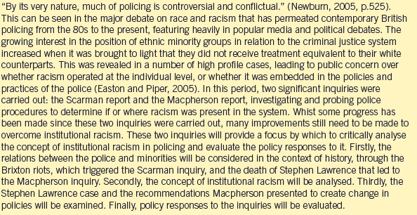
Notes:
Where are the references here?
We provide a reference in two places: i) in text citation ii) reference list. Why do we do this?

Slide 12
The anatomy of a reference
This is called the citation
Diemer and Ali (2009) discuss that familial wealth could provide a more comprehensive measurement of resources than household income and therefore is a more accurate measure of access to economic resources.
Diemer and Ali (2009)
Name, year

Slide 13
The anatomy of a reference
DIEMER, M. A. and ALI, S. R. (2009) Integrating social class into vocational psychology: Theory and practice implications. Journal of Career Assessment, 17 (3), pp. 247-265.
Notes:
What kind of a reference is this? Authors? Article title? Journal title? Volume number? Issue number? Pages?

Slide 14
Harvard Sample Reference List
HEUS, T. and JONKER, H.J.J. (2008) Subsiding shells around shallow cumulous clouds. Journal of atmospheric sciences. [Online] 65 (3). Available from: doi:org/10.1175/2007Jas2322.1[Accessed 28/06/16].
JSCREATIONZS (2012) Gears concept. [Online image] Available from: www.freedigitalphotos.net/ images/search.php?searc [Accessed 19/06/13].
MAIMON, D. and BROWNING, C. R. (2012) Adolescents’ violent victimization in the neighbourhood: situational and contextual determinants. British journal of criminology, 52 (4), pp. 808-833.
PATIENT.INFO (n.d.) Underactive thyroid gland (hypothyroidism). [Online] Patient.info. Available from: http://patient.info/health/underactive-thyroid-gland-hypothyroidism [Accessed 28/06/16].
SCHURK, H. (2015) Manipulations in imagined space. In: PERREN, C. and MLECEK, M. (eds.) Perception in architecture: here and now. Newcastle upon Tyne: Cambridge Scholars Publishing, pp. 78-85.
SEIDMAN, S. (2012) Contested knowledge. 5th ed. Hoboken, New Jersey: Wiley-Blackwell.
SHARDA, R., DELEN, D. and TURBAN, E. (2015) Business intelligence: a managerial perspective on analytics. London: Pearson Education.
SPSS (2015) SPSS Statistics. [Software] Version 22. Chicago: SPSS.
Notes:
Students to discuss: what are the sources:
Online journal article: Note: Journal articles taken from the Internet or a database should be cited as print. However, if the article is only available online, use the online format.
Online image
Journal article
Website (what is n.d.?)
Chapter in an edited book
Book (5th ed)
Book (1st ed)
Software

Slide 15
5 steps to good referencing
Always record reference details as you read and take notes
When writing: if quoting directly, always add a reference (include page numbers)
When writing: add a reference whenever you refer to someone else’s ideas, or wherever you want to ‘showcase’ your knowledge
Work out what it is you are referencing: book, chapter, article, website etc.
Use the prescribed referencing guide and follow the appropriate referencing template

Slide 16
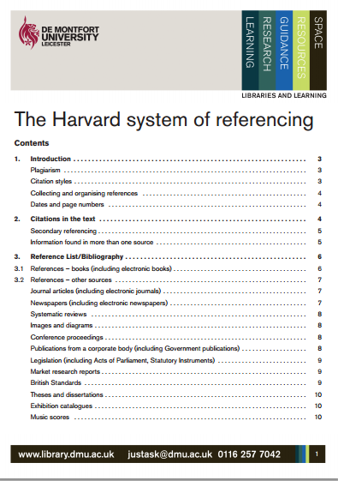
What to write in a reference list
https://libguides.library.dmu.ac.uk/refguide
https://libguides.library.dmu.ac.uk/harvardguide/welcome
http://www.library.dmu.ac.uk/Images/Selfstudy/Harvard.pdf
Notes:
Emphasise that other systems are available – show website for both Harvard and IEEE.

Slide 17

What is the difference between a reference list and a bibliography?

Slide 18
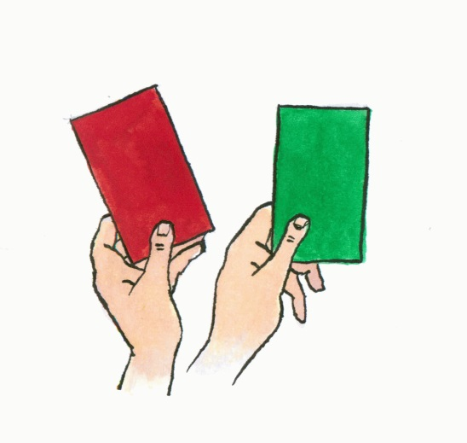
Activity 1
Good Academic Practice
Bad Academic Practice
Notes:
Academic writing is based on traceable evidence
Consistent system
3 reasons: To say thanks you., to be academic…use evidence, to be traceable….your reader can look up the sources.

Slide 19
Task: Identify good and bad practice
Listen to the following examples of citing and referencing and decide which is:
  Good practice = Green
  Bad practice = Red
  Questionable = Both

Slide 20

Example 1
You copy a paragraph making small changes (e.g. replacing a few verbs, and replacing an adjective with a synonym).
You put the source in the reference list.

Slide 21

Example 2
You quote a paragraph by placing it in a block format.
The source is cited in the text.
The source is cited in the reference list.

Slide 22
Example 3
You use the information from a table (e.g. home office statistics) to make a new diagram in your own work.
You put the source in the reference list.

Slide 23
Example 4
You compose a paragraph by taking short phrases from a number of sources and putting them together, adding in words of your own to make a coherent sentence.
You include all sources in your reference list.

Slide 24
Example 5
You paraphrase information from a number of sources making substantial changes in language and organisation.
The sources are cited in the text.
The source is cited in the reference list.

Slide 25
At a glance: using evidence in your writing
Evaluation
Critique
Summary
Paraphrase
Direct quote
Major changes
Minor changes
No change
Notes:
Hierarchy – how able you are to demonstrate higher level analytical skills.
Kahoot –Using sources to check meaning

Slide 26


Direct quotation
A direct quotation is a report of the exact words of an author or speaker.
A direct quotation is placed inside quotation marks.
Rogers and Green (2008, p.38) argue that ‘the family home has the greatest impact on educational development’.

Slide 27
Using direct quotations
Using direct quotations can be useful when:
The author’s style is clear and engaging
It is important that your reader knows the exact words an author has used to talk about a topic.

Slide 28
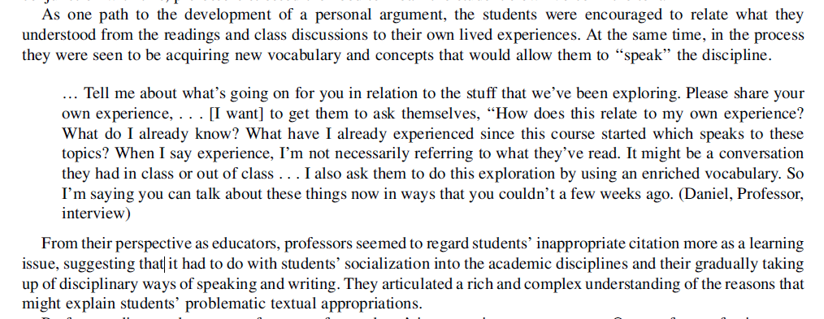
Block quotes/evidence from qualitative research
(Abasi and Graves 2008, p.227)
Notes:
Block quotes: separate out, justify to bigger margins.

Slide 29
Stop and Think
  Why do I want to use this direct quote?
  How does it relate to my argument?
  Have I analysed and evaluated it?

Slide 30

Paraphrasing
A paraphrase reports on what a person said without using the exact words of the speaker.
A paraphrase is not placed in quotation marks
A child’s educational progress is most influenced by their home life (Rogers and Green, 2008).

Slide 31
Issues with poor paraphrasing
No suitable in-text citation
Minimal changes focus on replacing words and phrases with alternatives (‘synonyms’) but the sentence structure and order of points remains identical
Verdict: plagiarised

Slide 32

A paraphrasing example

Slide 33
The original:
Indirect delivery via institutions such as the World Bank may mean that UK charity contributions are lost to corrupt practices (Gates, 2008)
becomes…
Gates (2008) argues that UK charity contributions may be lost through corrupt practices if they are distributed by institutions such as the World Bank.
..which then becomes….
Gates (2008) argues that UK charity funds could disappear through corruption if they are dispensed by organisations such as the World Bank.

Slide 34
Paraphrasing
Now you try:
Competition amongst charities has never been greater than it is at the moment (Briggs, 2011).
Notes:
In the present climate, charities have been forced to compete for donations.
Charities are increasingly in competition with each other.

Slide 35
At a glance: using evidence in your writing
Evaluation
Critique
Summary
Paraphrase
Direct quote
Major changes
Minor changes
No change
Notes:
Kahoot –Using sources to check meaning

Slide 36
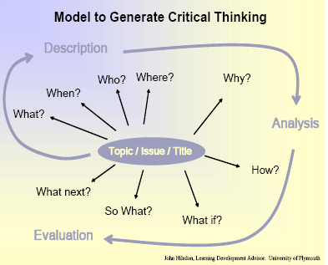
Critical questions
https://www.plymouth.ac.uk/uploads/production/document/path/1/1710/Critical_Thinking.pdf

Slide 37
Extract 1
An experiment carried out by Smith (1997) showed that students do better in exams that contribute to their final grade than in those that are merely ‘pass and proceed’; this showed that motivation is an important factor in improving students’ examination performance. Patel (1995) believes that students should be given past papers to help them to increase their confidence, but Jones (1998) thinks that this can lead to students revising only those topics that come up regularly. Essay-type questions are better than short-answer questions because they test creative thinking and not just memory (McPherson, 1997).
red font = analysis/evaluation

Slide 38
Extract 2
Recent published research on the effectiveness of examinations as an assessment technique has highlighted the importance of motivation as a driving force (for example, Patel, 1995; Smith, 1997; Jones, 1998). Patel and Jones disagree about whether or not past papers can be useful in helping students, but it could be argued that without some clear examples of at least the types of questions that are likely to be asked, students are not able to plan an effective revision strategy. What is important though, is not just the context in which examinations are used, but the format of the examinations themselves. McPherson (1997) argued against short-answer questions, which he saw as only capable of testing memory and not creative thinking. In his criticism of this type of examination, he has failed to acknowledge the importance of providing opportunities for students to develop a wider range of written communication skills than those developed by essay writing. The ability to write briefly and effectively is a very valuable skill for future employment; discursive essays are a form of writing that is very rarely used in the world of work.
red font = analysis/evaluation

Slide 39
In this session we will think about …
The anatomy of a citation/reference
Avoiding plagiarism
Direct quotations and paraphrasing

Slide 40



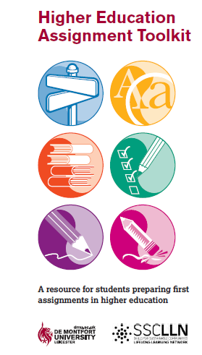
Centre for Learning and Study Support
Enhancing academic practice, writing development and professional skills
Tutorials and Drop-in
Workshops
Workshops run every two weeks: Keep an eye out on blackboard and MyDMU to see our upcoming sessions
To sign up go the library what’s on page: www.library.dmu.ac.uk/Home/Calendar
Book a 30 minute one-to-one appointment to discuss any aspect of your study or work: visit the Library “What’s on?” page to book.
Just a quick question? Drop in every Monday, Wednesday, Friday, 2-3pm, Tuesday and Thursday 5-6pm in the LDZ Kimberlin library where CLaSS will be waiting to answer your question!
Guides
To view our online resources go to: www.library.dmu.ac.uk/link/CLASS
To help fit the pieces of your study together visit: www.library.dmu.ac.uk/link/CLASS

